Slide 1
DataBase Management System Lab (4CS4-22) Experiment No. -10 13-7-2021(Saturday) Topic to be covered : Procedures

Slide 2
Procedures − These subprograms do not return a value directly; mainly used to perform an action.
Parts of a PL/SQL Subprogram
S.No | Parts & Description
1 | Declarative Part It is an optional part. However, the declarative part for a subprogram does not start with the DECLARE keyword. It contains declarations of types, cursors, constants, variables, exceptions, and nested subprograms. These items are local to the subprogram and cease to exist when the subprogram completes execution.
2 | Executable Part This is a mandatory part and contains statements that perform the designated action.
3 | Exception-handling This is again an optional part. It contains the code that handles run-time errors.

Slide 3
Creating a Procedure:
A procedure is created with the CREATE OR REPLACE PROCEDURE statement.
The simplified syntax for the CREATE OR REPLACE PROCEDURE statement is as follows −
CREATE [OR REPLACE] PROCEDURE procedure_name
[(parameter_name [IN | OUT | IN OUT] type [, ...])]
{IS | AS}
BEGIN
< procedure_body >
END procedure_name;

Slide 4
Where,
procedure-name specifies the name of the procedure.
[OR REPLACE] option allows the modification of an existing procedure.
The optional parameter list contains name, mode and types of the parameters.
IN represents the value that will be passed from outside and OUT represents the parameter that will be used to return a value outside of the procedure.
procedure-body contains the executable part.
The AS keyword is used instead of the IS keyword for creating a standalone procedure.

Slide 5
Example:
CREATE OR REPLACE PROCEDURE greetings
AS
BEGIN
dbms_output.put_line('Hello World!');
END; /
Executing a Standalone Procedure
A standalone procedure can be called in two ways −
Using the EXECUTE keyword
Calling the name of the procedure from a PL/SQL block
EXECUTE greetings;
Or
BEGIN
greetings;
END;

Slide 6
Deleting a Standalone Procedure:
Syntax:
DROP PROCEDURE procedure-name;
Example:
DROP PROCEDURE greetings;

Slide 7
Parameter Modes in PL/SQL Subprograms:
1. IN: An IN parameter lets you pass a value to the subprogram. It is a read-only parameter. Inside the subprogram, an IN parameter acts like a constant. It cannot be assigned a value. You can pass a constant, literal, initialized variable, or expression as an IN parameter. You can also initialize it to a default value.
2. OUT: An OUT parameter returns a value to the calling program. Inside the subprogram, an OUT parameter acts like a variable. You can change its value and reference the value after assigning it.
3. IN OUT :An IN OUT parameter passes an initial value to a subprogram and returns an updated value to the caller. It can be assigned a value and the value can be read.

Slide 8
IN & OUT Mode Example 1
This program finds the minimum of two values. Here, the procedure takes two numbers using the IN mode and returns their minimum using the OUT parameters.
DECLARE
a number;
b number;
c number;
PROCEDURE findMin(x IN number, y IN number, z OUT number)
IS
BEGIN
IF x < y
THEN
z:= x;
ELSE
z:= y;
END IF;
END;
BEGIN
a:= 23;
b:= 45;
findMin(a, b, c);
dbms_output.put_line(' Minimum of (23, 45) : ' || c);
END;

Slide 9
DECLARE
a number;
PROCEDURE squareNum(x IN OUT number)
IS
BEGIN
x := x * x;
END;
BEGIN
a:= 23;
squareNum(a);
dbms_output.put_line(' Square of (23): ' || a);
END; /

Slide 10
create table user(id number(10) primary key,name varchar2(100));
create or replace procedure "INSERTUSER"
(id IN NUMBER,
name IN VARCHAR2)
is
begin
insert into user values(id,name);
end;
/
BEGIN
insertuser(101,'Rahul');
dbms_output.put_line('record inserted successfully');
END;

Slide 11
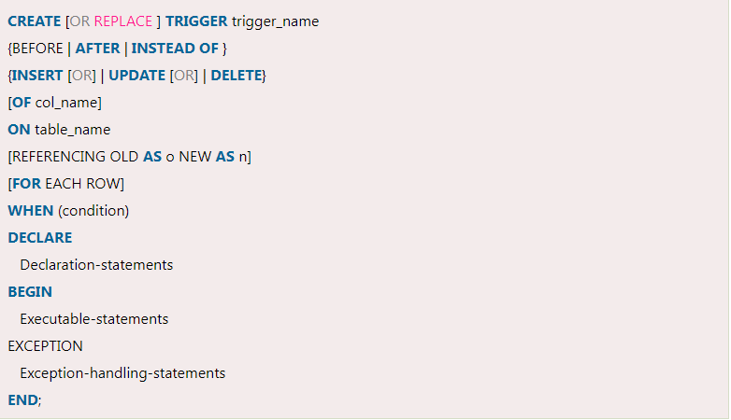

Slide 12
CREATE [OR REPLACE] TRIGGER trigger_name: It creates or replaces an existing trigger with the trigger_name.
{BEFORE | AFTER | INSTEAD OF} : This specifies when the trigger would be executed. The INSTEAD OF clause is used for creating trigger on a view.
{INSERT [OR] | UPDATE [OR] | DELETE}: This specifies the DML operation.
[OF col_name]: This specifies the column name that would be updated.
[ON table_name]: This specifies the name of the table associated with the trigger.
[REFERENCING OLD AS o NEW AS n]: This allows you to refer new and old values for various DML statements, like INSERT, UPDATE, and DELETE.
[FOR EACH ROW]: This specifies a row level trigger, i.e., the trigger would be executed for each row being affected. Otherwise the trigger will execute just once when the SQL statement is executed, which is called a table level trigger.
WHEN (condition): This provides a condition for rows for which the trigger would fire. This clause is valid only for row level triggers.

Slide 13
CREATE OR REPLACE TRIGGER display_salary_changes
BEFORE DELETE OR INSERT OR UPDATE ON customers
FOR EACH ROW
WHEN (NEW.ID > 0)
DECLARE
sal_diff number;
BEGIN
sal_diff := :NEW.salary - :OLD.salary;
dbms_output.put_line('Old salary: ' || :OLD.salary);
dbms_output.put_line('New salary: ' || :NEW.salary);
dbms_output.put_line('Salary difference: ' || sal_diff);
END;
/
INSERT INTO CUSTOMERS (ID,NAME,AGE,ADDRESS,SALARY) VALUES (7, 'Kriti', 22, 'HP', 7500.00 );
UPDATE customers SET salary = salary + 500 WHERE id = 2;

